Slide 1
Front-end build tools
Rany Tarek Bouorm
Notes:
Intro – Rany - Utvikler hos STB
For det meste React apps
Frontend build tools
Bakgrunn:
Nysgjerrig av natur
Irriterende kiden – "hvorfor det?"
Skrudde ting fra hverandre
Første møte med React under studiet - neste

Slide 2
Agenda
What are front end build tools?
Introduction to Webpack
Webpack excercises – Make a React starter
Notes:
Komfortabelt å lære React
Et av salgspunktene med CRA

Slide 3
Before modern build tools
Manual dependency management
Manual handling of browser compatibility
Manually preparing files for production

Slide 4

Create React App
No Lock-In
Under the hood, we use webpack, Babel, ESLint, and other amazing projects to power your app. If you ever want an advanced configuration, you can ”eject” from Create React App and edit their config files directly.
Notes:
Komfortabelt å lære React
Et av salgspunktene med CRA

Slide 5
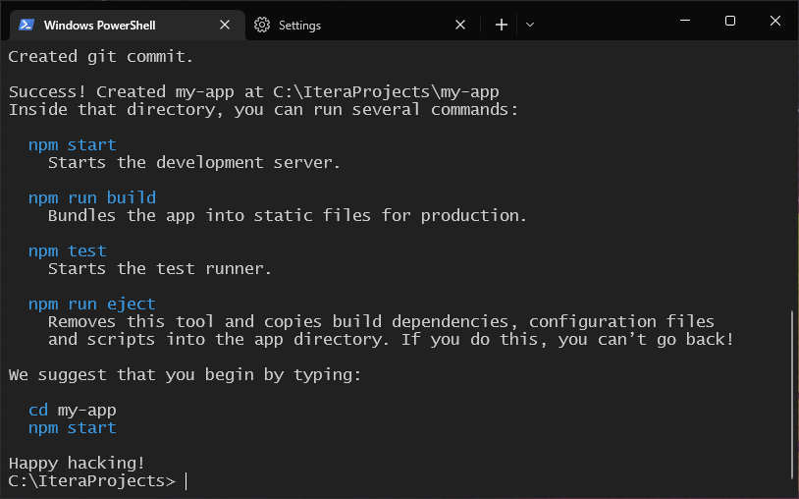
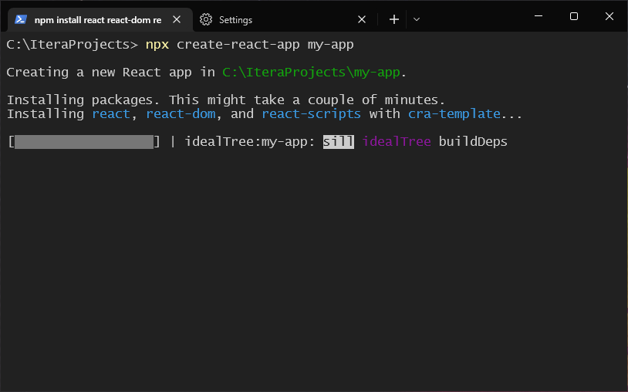
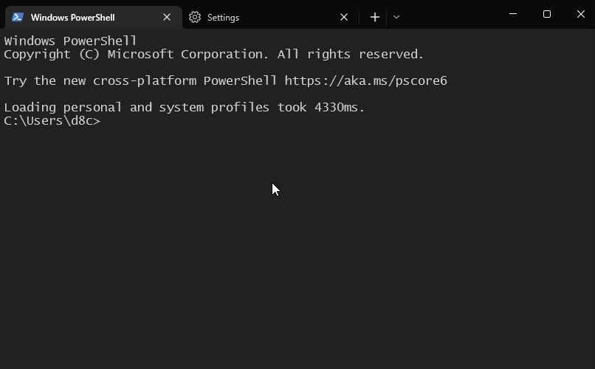
Create React App

Slide 6
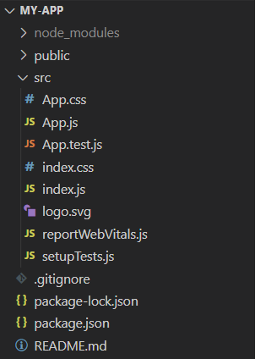
Basic Create React App structure

Slide 7
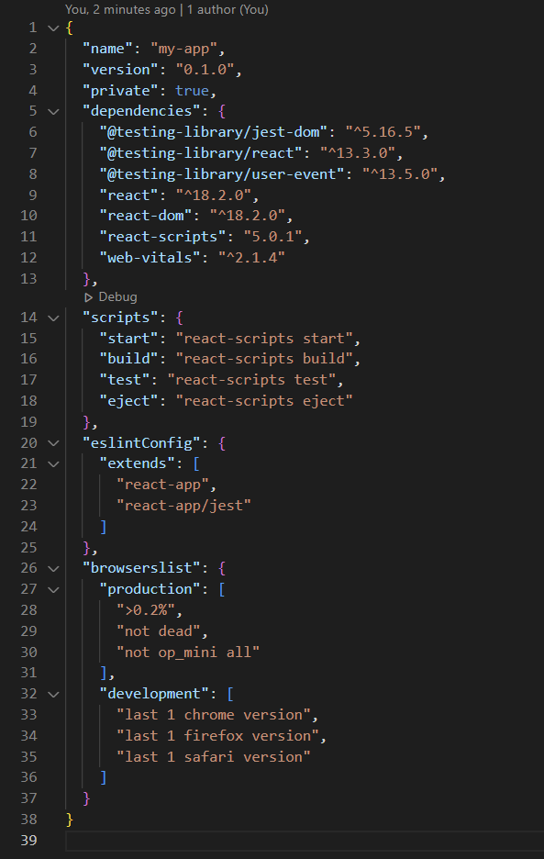
package.json
Notes:
But how?
Jeg hadde en CRA app hos Storebrand
ny funksjonalitet som krever webpack config

Slide 8
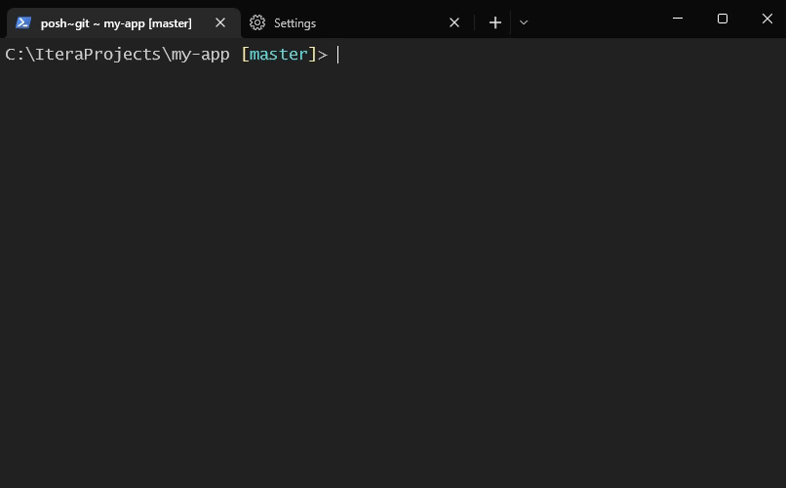
Let's eject

Slide 9
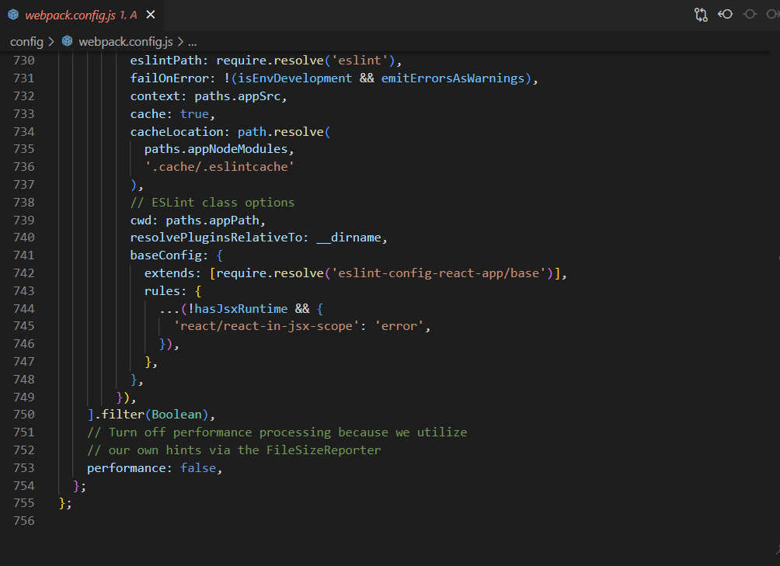
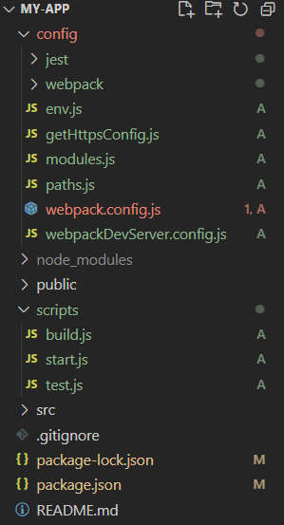
Ejected Create React App
"dependencies": {
"@babel/core": "^7.16.0",
"@pmmmwh/react-refresh-webpack-plugin": "^0.5.3",
"@svgr/webpack": "^5.5.0",
"@testing-library/jest-dom": "^5.16.5",
"@testing-library/react": "^13.3.0",
"@testing-library/user-event": "^13.5.0",
"babel-jest": "^27.4.2",
"babel-loader": "^8.2.3",
"babel-plugin-named-asset-import": "^0.3.8",
"babel-preset-react-app": "^10.0.1",
"bfj": "^7.0.2",
"browserslist": "^4.18.1",
"camelcase": "^6.2.1",
"case-sensitive-paths-webpack-plugin": "^2.4.0",
"css-loader": "^6.5.1",
"css-minimizer-webpack-plugin": "^3.2.0",
"dotenv": "^10.0.0",
"dotenv-expand": "^5.1.0",
"eslint": "^8.3.0",
"eslint-config-react-app": "^7.0.1",
"eslint-webpack-plugin": "^3.1.1",
"file-loader": "^6.2.0",
"fs-extra": "^10.0.0",
"html-webpack-plugin": "^5.5.0",
"identity-obj-proxy": "^3.0.0",
"jest": "^27.4.3",
"jest-resolve": "^27.4.2",
"jest-watch-typeahead": "^1.0.0",
"mini-css-extract-plugin": "^2.4.5",
"postcss": "^8.4.4",
"postcss-flexbugs-fixes": "^5.0.2",
"postcss-loader": "^6.2.1",
"postcss-normalize": "^10.0.1",
"postcss-preset-env": "^7.0.1",
"prompts": "^2.4.2",
"react": "^18.2.0",
"react-app-polyfill": "^3.0.0",
"react-dev-utils": "^12.0.1",
"react-dom": "^18.2.0",
"react-refresh": "^0.11.0",
"resolve": "^1.20.0",
"resolve-url-loader": "^4.0.0",
"sass-loader": "^12.3.0",
"semver": "^7.3.5",
"source-map-loader": "^3.0.0",
"style-loader": "^3.3.1",
"tailwindcss": "^3.0.2",
"terser-webpack-plugin": "^5.2.5",
"web-vitals": "^2.1.4",
"webpack": "^5.64.4",
"webpack-dev-server": "^4.6.0",
"webpack-manifest-plugin": "^4.0.2",
"workbox-webpack-plugin": "^6.4.1"
}

Slide 10


Let's start from scratch
function sayHello() {
console.log("Hello world!");
}
sayHello();

Slide 11

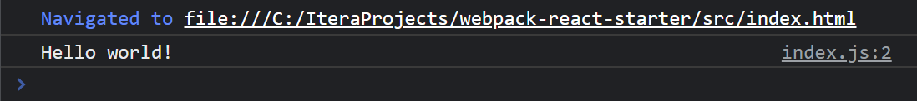
Let's start from scratch

Slide 12

import { sayHello } from "./utils";
sayHello();
export function sayHello() {
console.log("Hello world!");
}

Slide 13
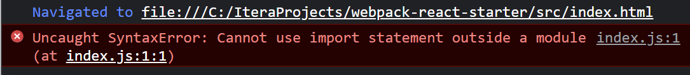
Notes:
This is because the import/export syntax is a ES module feature. This is actually supported in most browsers now by specifiing type="module" on the script tag.

Slide 14
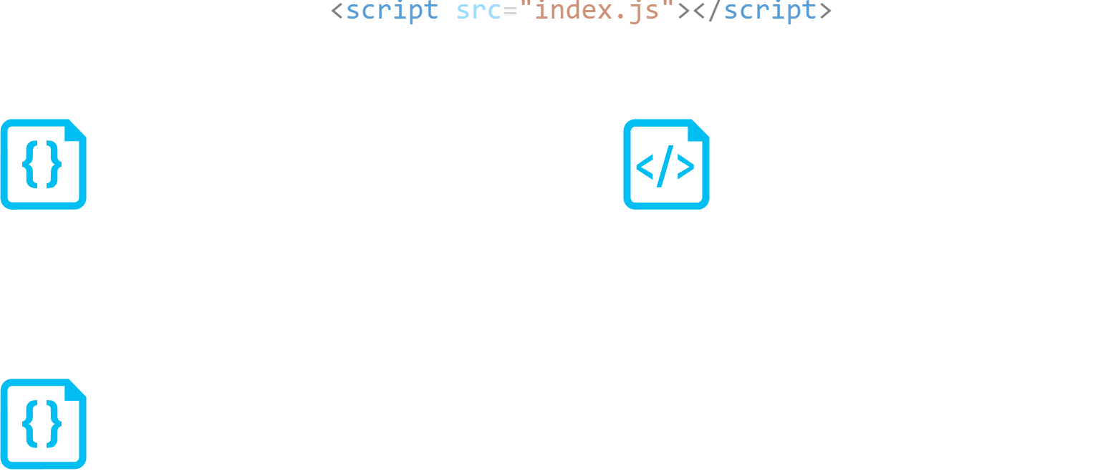
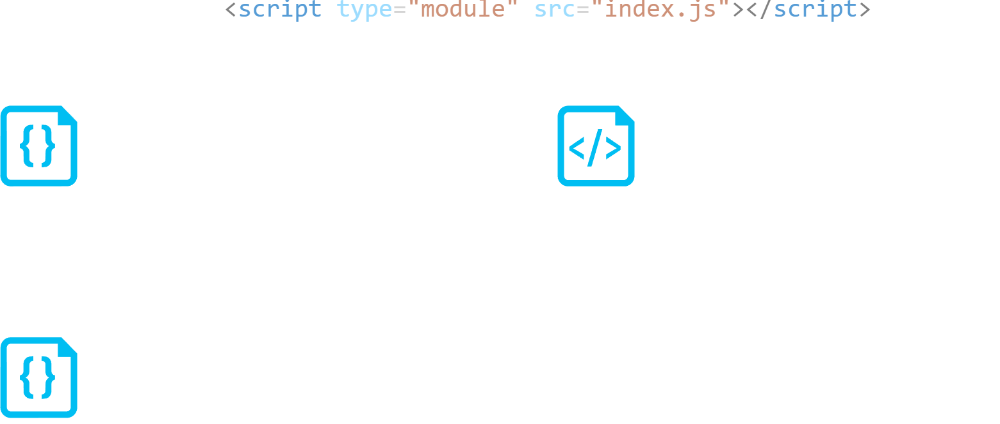

Slide 15
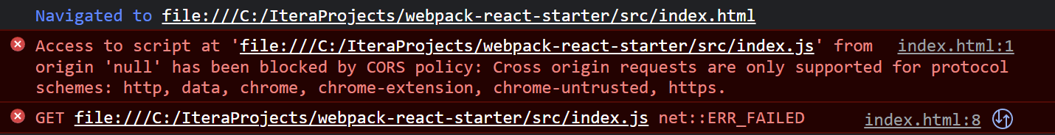
Notes:
Could be solved by using a web server, so the origin is not "null"

Slide 16
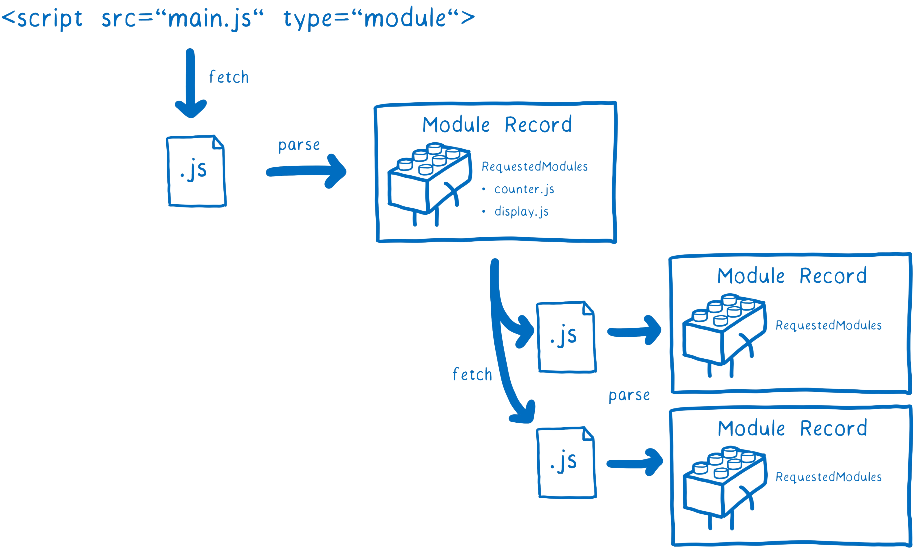

Slide 17
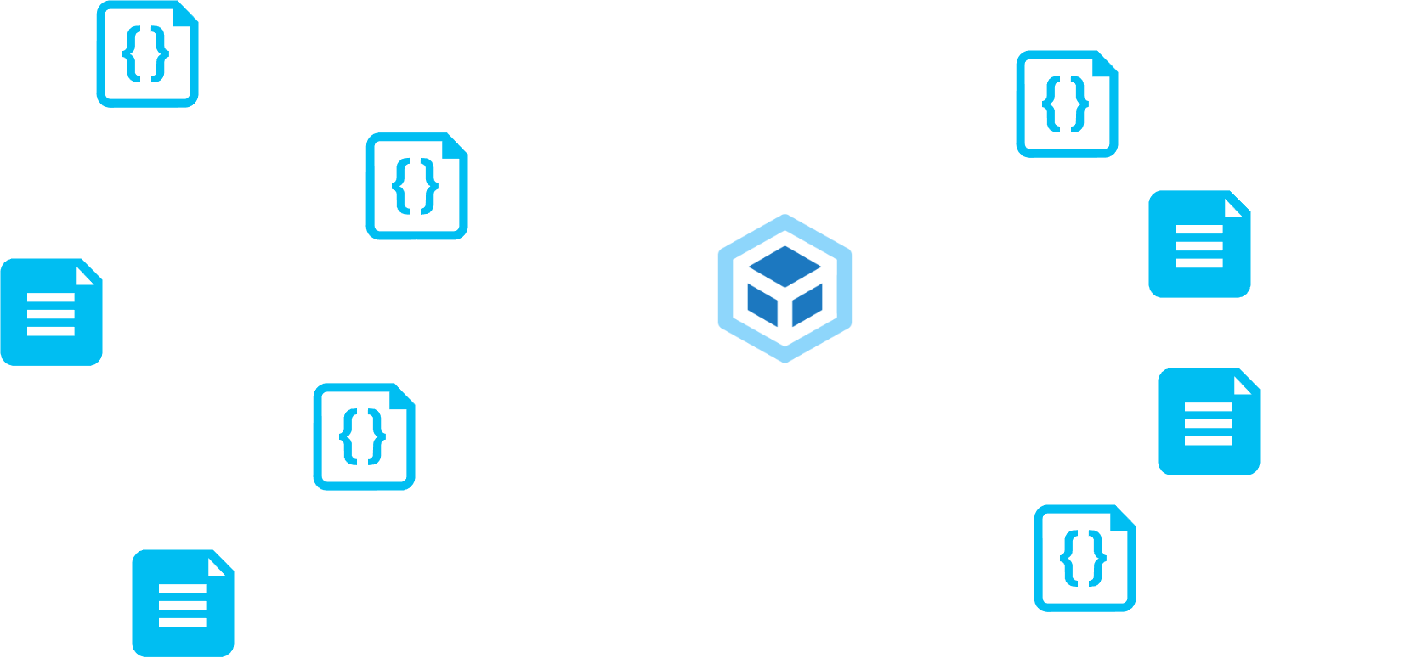

MODULES WITH DEPENDENCIES
STATIC ASSETS

Slide 18
Common tasks of webpack
Resolve dependencies
Create dependency graph
Remove unused code (Tree shaking)
Determine correct order to bundle the code in
Bundle files
Less requests to load a web page
Improves performence
Handle browser compatibility
Transpile code to older JS versions
Add polyfills
Preparing files for production
Minifying
Uglifying
Dev server
Code splitting
Reduce initial load time
Handle configs for different environments
Proxies
Source maps
Notes:
Komfortabelt å lære React
Et av salgspunktene med CRA

Slide 19
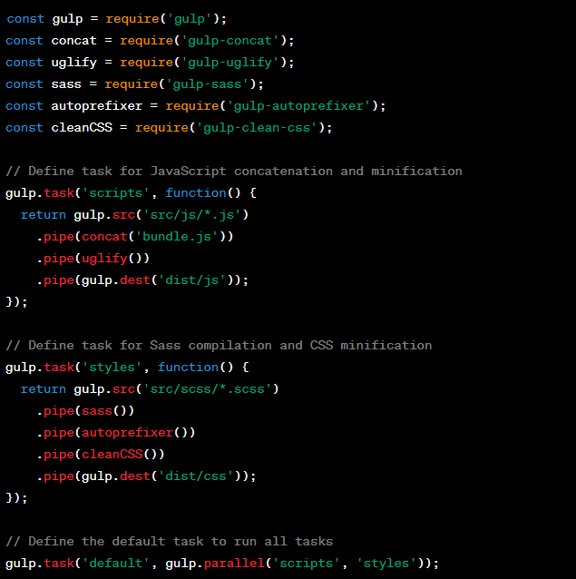
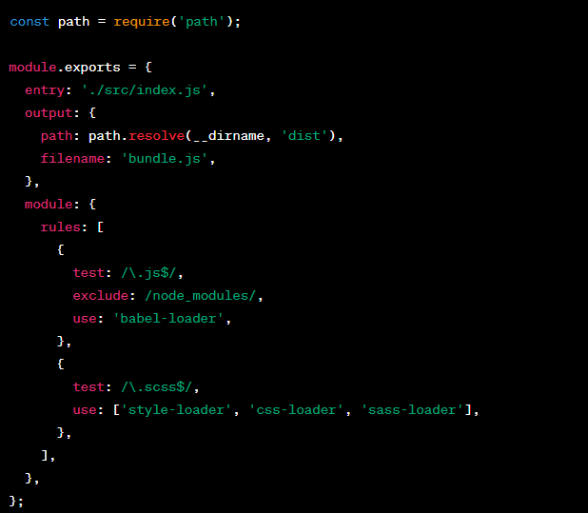
What about other build tools?
Notes:
Komfortabelt å lære React
Et av salgspunktene med CRA

Slide 20

MODULES WITH DEPENDENCIES
STATIC ASSETS
Notes:
Out of the box, webpack only understands javascript and json

Slide 21
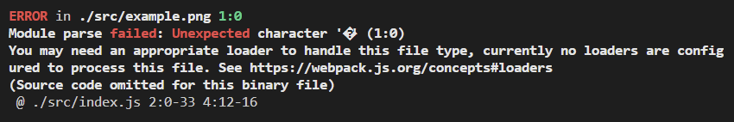
Notes:
We need something to resolve this import
Webpack enables use of loaders to preprocess files. This allows you to bundle any static resource way beyond JavaScript.

Slide 22
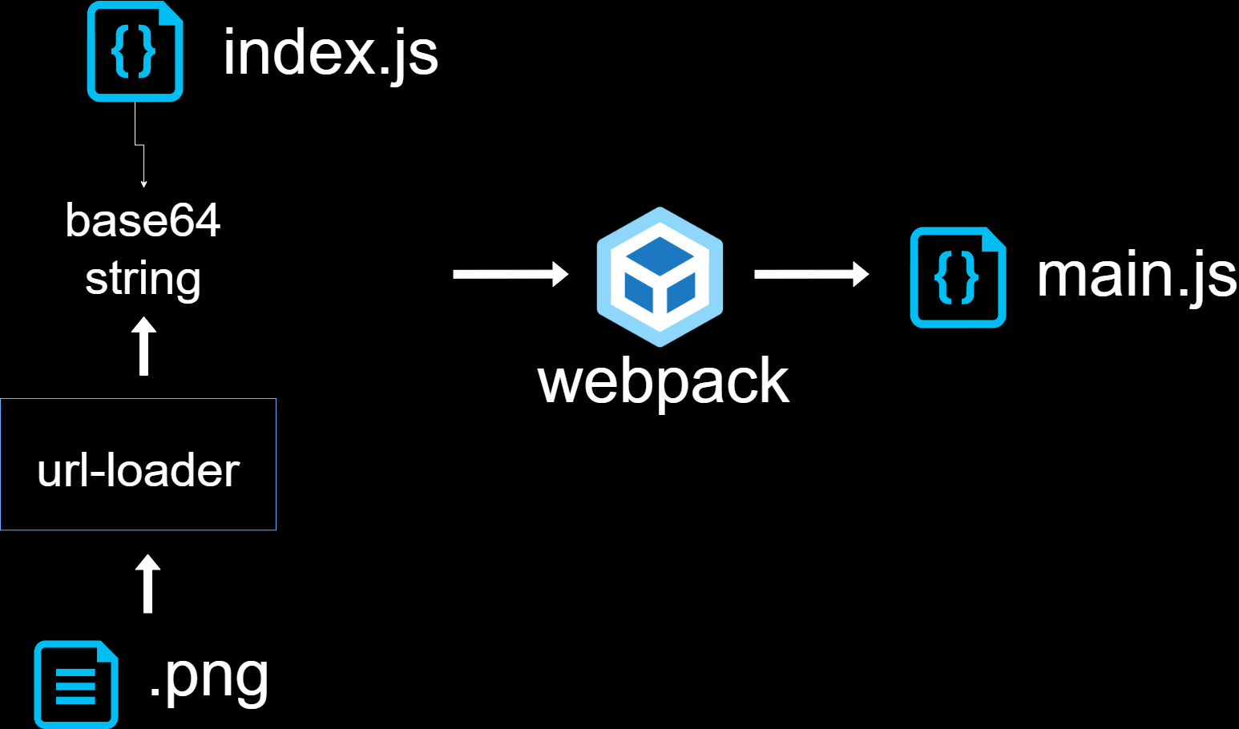
Notes:
Webpack enables use of loaders to preprocess files. This allows you to bundle any static resource way beyond JavaScript.

Slide 23
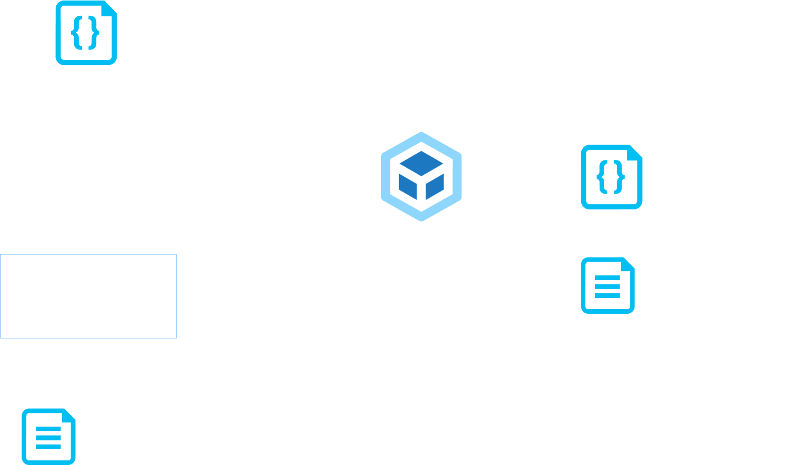
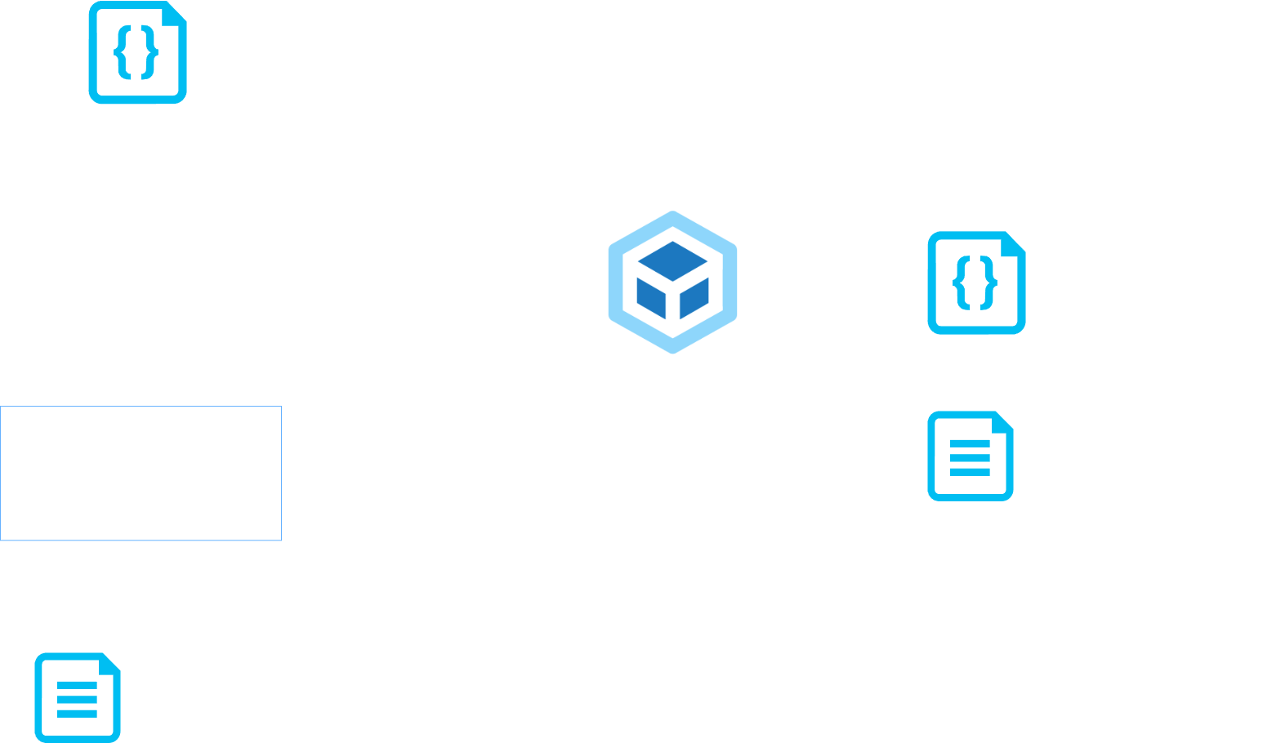
Notes:
Webpack enables use of loaders to preprocess files. This allows you to bundle any static resource way beyond JavaScript.

Slide 24
Common webpack loaders
url-loader
file-loader
style-loader
ts-loader
babel-loader
Notes:
File-loader resolves import/require() on a file into a url and emits the file into the output directory.
Style-loader injects css into the DOM
Babel-loader converts code into older versions of javascript

Slide 25
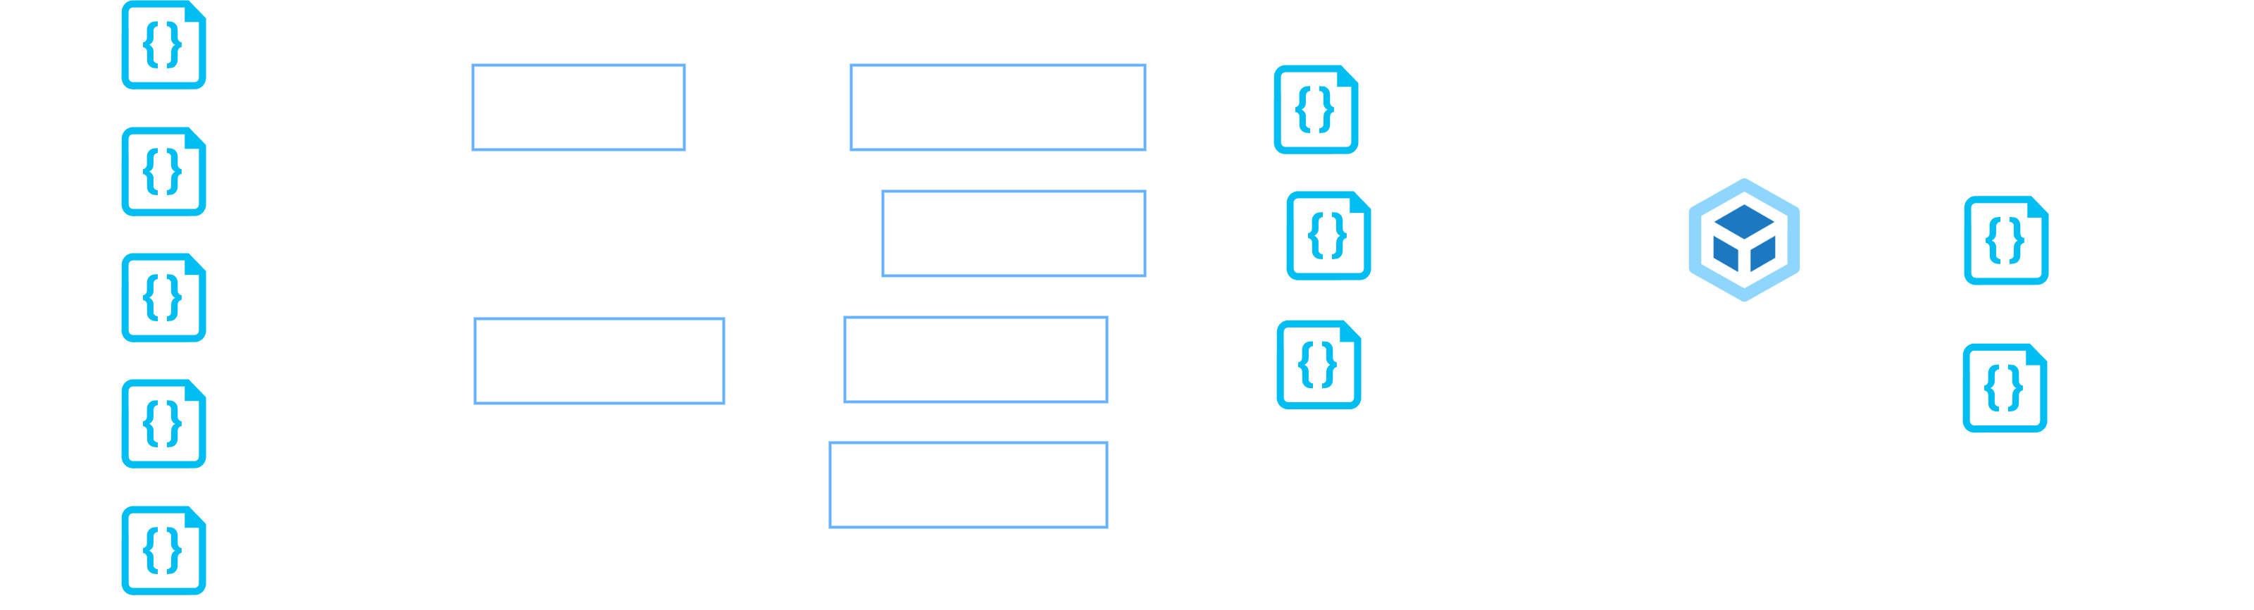
Notes:
Webpack in a nutshell
Verktøyet som binder alle verktøyene sammen
Kunne kjørt tsc, babel, så webpack, men med loaders går det uten
Oppfordring:
Grav i det du ikke skjønner
Plukk ting fra hverandre
Start fra scratch når for komplekst

Slide 26
Core concepts of webpack
Entry
Output
Mode
Loaders
Plugins
Modules
Notes:
Komfortabelt å lære React
Et av salgspunktene med CRA

Slide 27
MODULES WITH DEPENDENCIES
STATIC ASSETS
Notes:
Out of the box, webpack only understands javascript and json

